Slide 1

Core Web Vitals Measure User Experience
🎨
📱

Slide 2
Core Web Vitals
🎨
📱
LCP Largest Contentful Paint Loading Performance
INP Interaction to Next Paint Interactivity
CLS Cumulative Layout Shift Visual Stability

Slide 3
Core Web Vitals - LCP
🎨
LCP Largest Contentful Paint
GOOD
TO IMPROVE
POOR
2.5 sec
4 sec
https://web.dev/lcp/

Slide 4

Core Web Vitals LCP
🎨
LCP Largest Contentful Paint
Measures time until page’s main content has loaded
perceived load speed

Slide 5
NEW Web Vitals - INP (replaces FID in March 12th)
INP Interaction to Next Paint
GOOD
TO IMPROVE
POOR
200ms
500ms
https://web.dev/inp/

Slide 6
INP
Input received
Frame resented
Event: click
Input delay
Processing Time
Render & Paint
Longest event duration of the interaction. This value is the interaction latency

Slide 7
Core Web Vitals - CLS
CLS Cumulative Layout Shift
GOOD
TO IMPROVE
POOR
0.1
0.25
https://web.dev/cls/

Slide 8

Core Web Vitals CLS
CLS Cumulative Layout Shift
Amount of layout shifts calculated as a factor visual stability
impact fraction * distance fraction

Slide 9
Other Web Vitals

Slide 10
Other Web Vitals
TTFB Time to First Byte
FCP First Contentful Paint
TBT Total Blocking Time
TTI Time To Interactive
Loading Experience
Interactivity

Slide 11

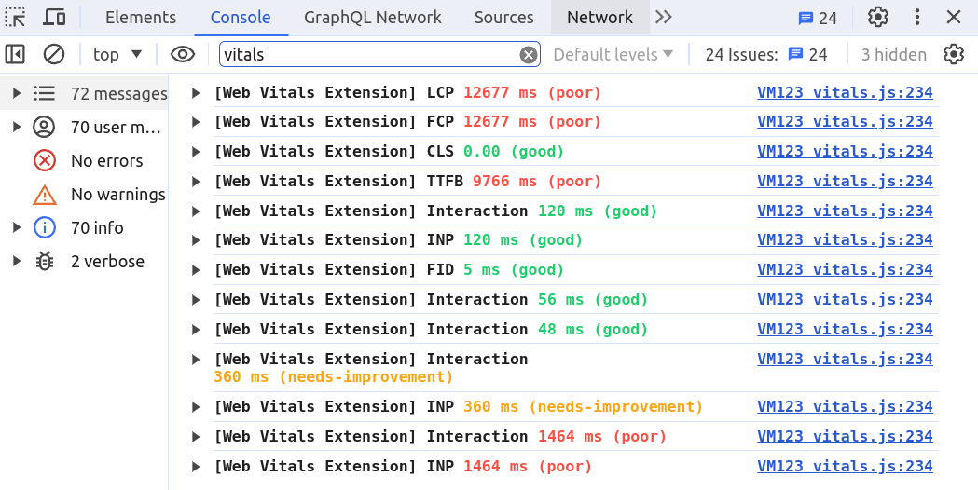
Web Vitals Chrome Extension

Slide 12

Core Web Vitals FID
📱
FID First Input Delay
Time until page is ready to receive user input load responsiveness

Slide 13

Demo Time!
Web Vitals Extension
Exercise

Slide 14
Core Web Vitals - FID is replaced with a new metrics
📱
FID First Input Delay
GOOD
TO IMPROVE
POOR
100 ms
300 ms
https://web.dev/fid/

Slide 15
Core Web Vitals - FID
📱
FID First Input Delay
GOOD
TO IMPROVE
POOR
100 ms
300 ms
https://web.dev/fid/

